Slide 1
Principles final project
Final project
Nabeega Latif 100791489
Faizan Mohammed 100707731
Mohammed Fawal 100704653

Slide 2
Our goal
Create a smooth shopping website for customers
Have multiple options and items
Log-in interface
Have a clean checkout system using Stripe
Display of items at checkout

Slide 3
Key Requirements
Add items to cart
Account creation
User adding shipping information to cart
User adding payment details to checkout

Slide 4
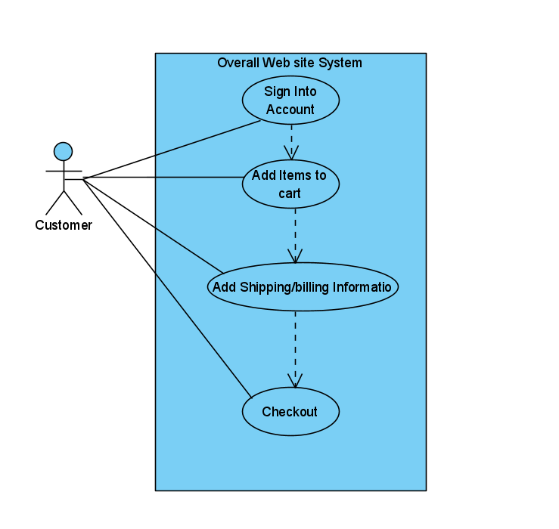
Example of Important Use Case

Slide 5
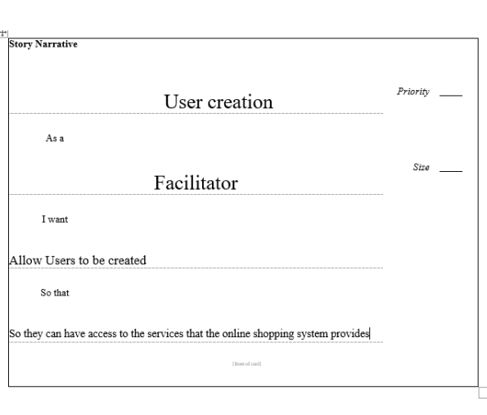
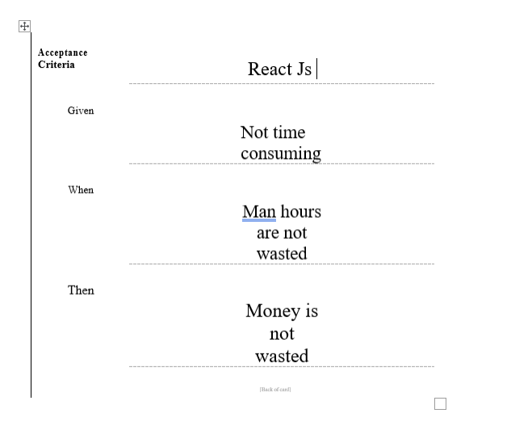
User stories

Slide 6
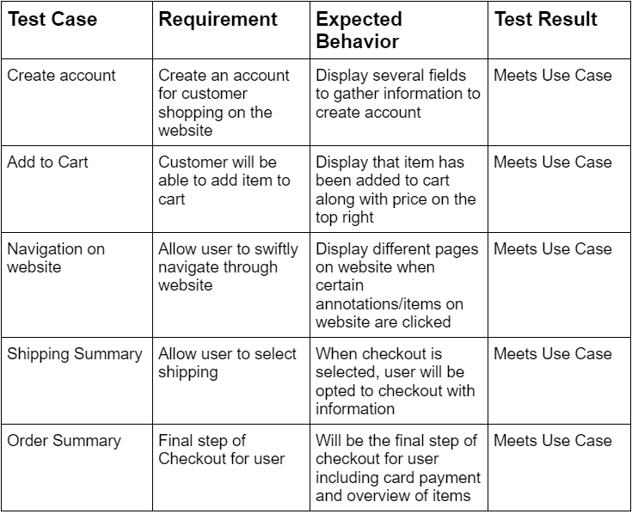
Test Case Plans

Slide 7
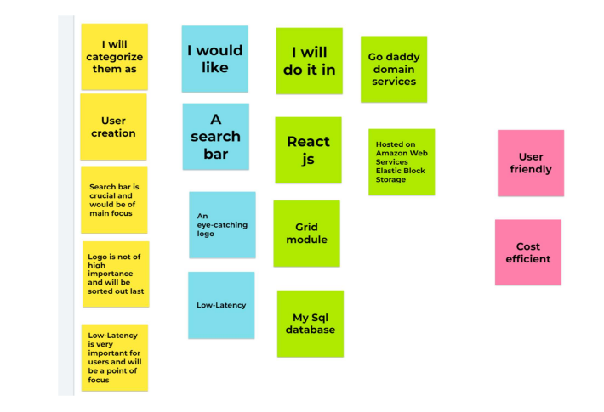
Jam session

Slide 8
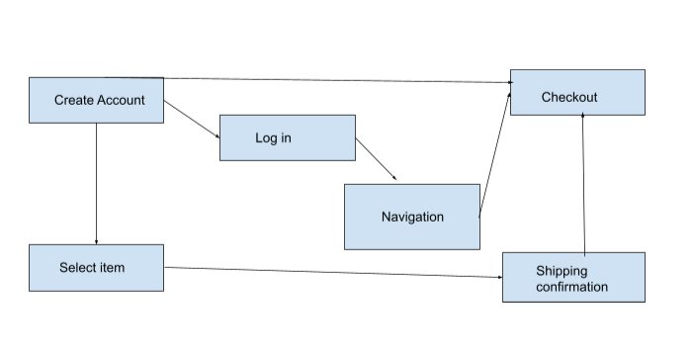
Conceptual Model

Slide 9
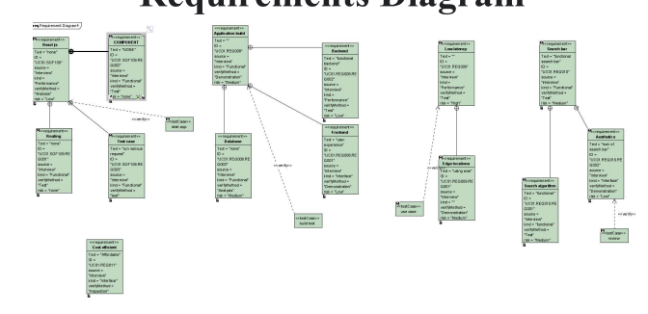
Requirements diagram

Slide 10
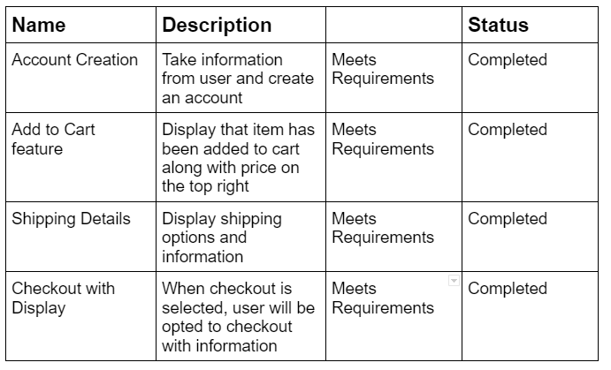
Key Requirements

Slide 11
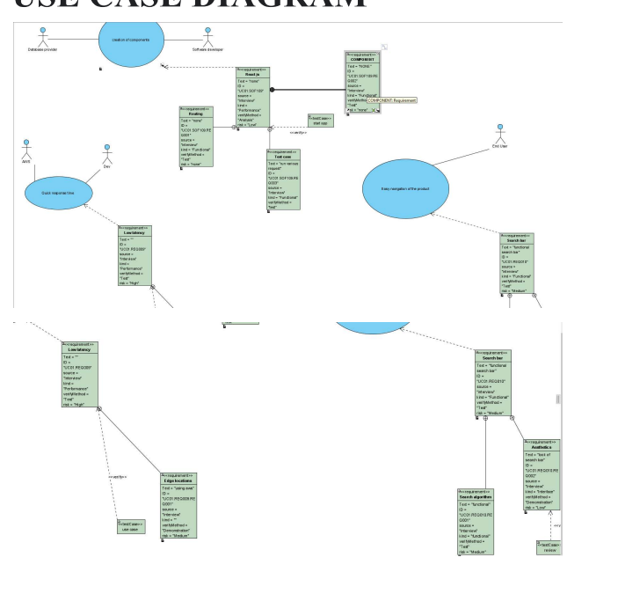
Use case diagram

Slide 12
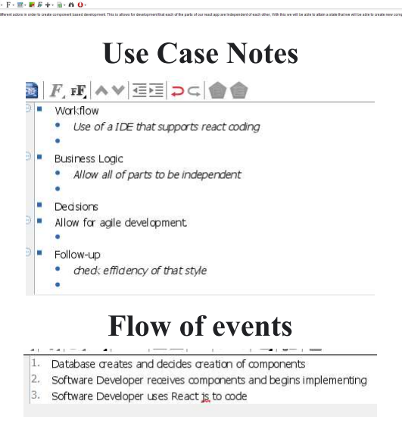
Notes on Use case

Slide 13
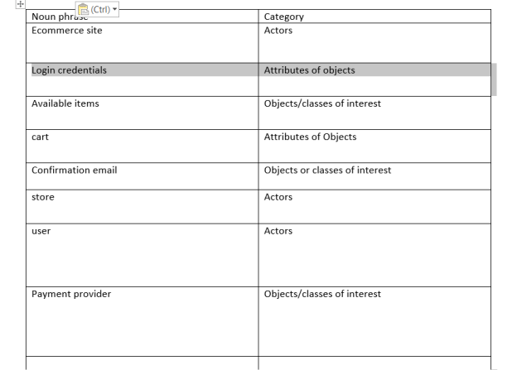
Table of definition

Slide 14
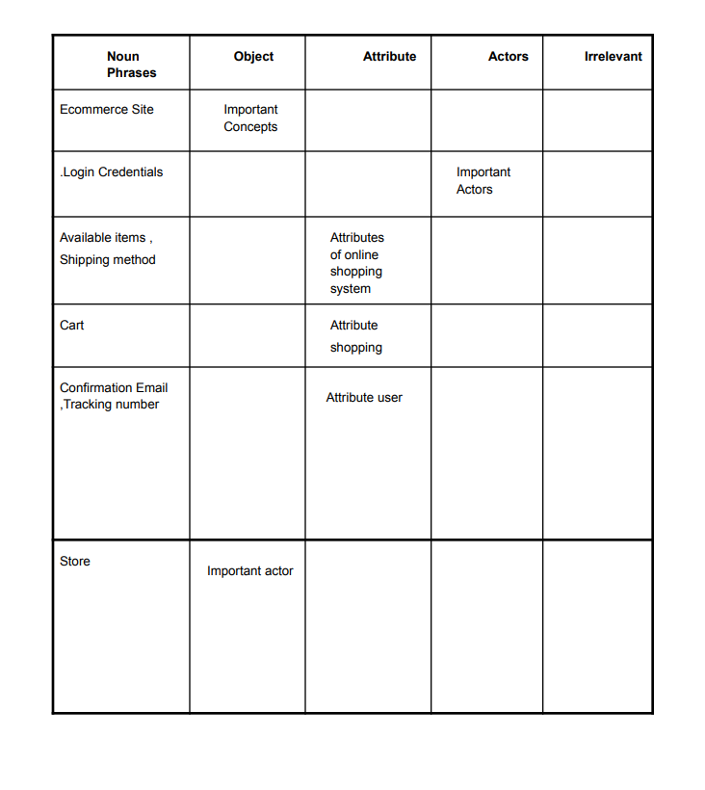
Another table

Slide 15
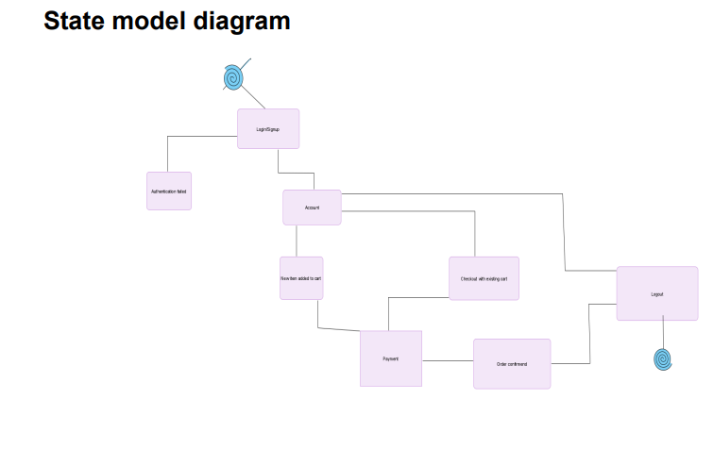
State model diagram

Slide 16
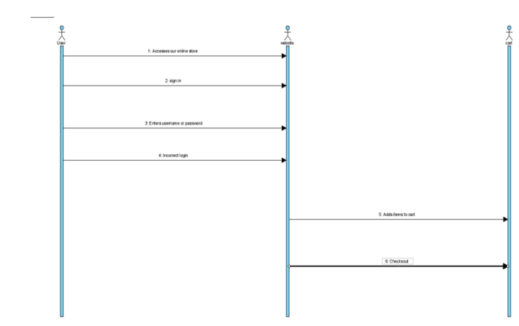
Sequence diagram

Slide 17
Demonstration time
Present website

